Slide 1
Strengthening Outcomes & Assessment in Residency
A community of practice sponsored by AFMRD and ABFM Foundation
March 2023
Notes:
Jay to introduce session

Slide 2
Objectives
At the end of this session, residency leaders will be able to:
  Describe SOAR and the key underlying principles
  Compare and contrast which data/indicators are critical for residency program evaluations and self-studies to meet program requirements
  Suggest priority areas for residency outcomes research within the program and across the community
  Imagine how GME innovations in family medicine lead to specific graduate outcomes
  Provide input into the design of the SOAR Community of Practice and request more information to participate.

Slide 3
Agenda
  Lunch
  Introductions & What is SOAR
  Example of Residency Outcomes Research
  Value of Residency Outcomes Research for Residency Program Leaders
  Table Talk: Conversational Leadership: Residency Program Outcomes
  Open Mic with Question and Answers
Notes:
Intro: Warren (2-3 min)
What is SOAR?: Sarah (5-7 min)
One Example of Outcomes Research: Lars & Wendy (10-12 min)
How to use available data to assess outcomes
Leveraging NGS as initial step
Value of Outcomes Research for PDs as Relates to Revised ACGME FM Requirements: Sarah (2 min)
Aspirational Data Sources: Wendy (1-2 min)
Table Discussions (45-60 minutes, dependent on vibe of room)
Open Mic or AES Q&A (0-15 minutes, dependent on vibe of room)

Slide 4
The ultimate outcome of graduate medical education is excellence in resident education and patient care
Section II.A.2. Background and intent
Notes:
Sarah and Warren have a conversation….what is a residency outcome?

Slide 5
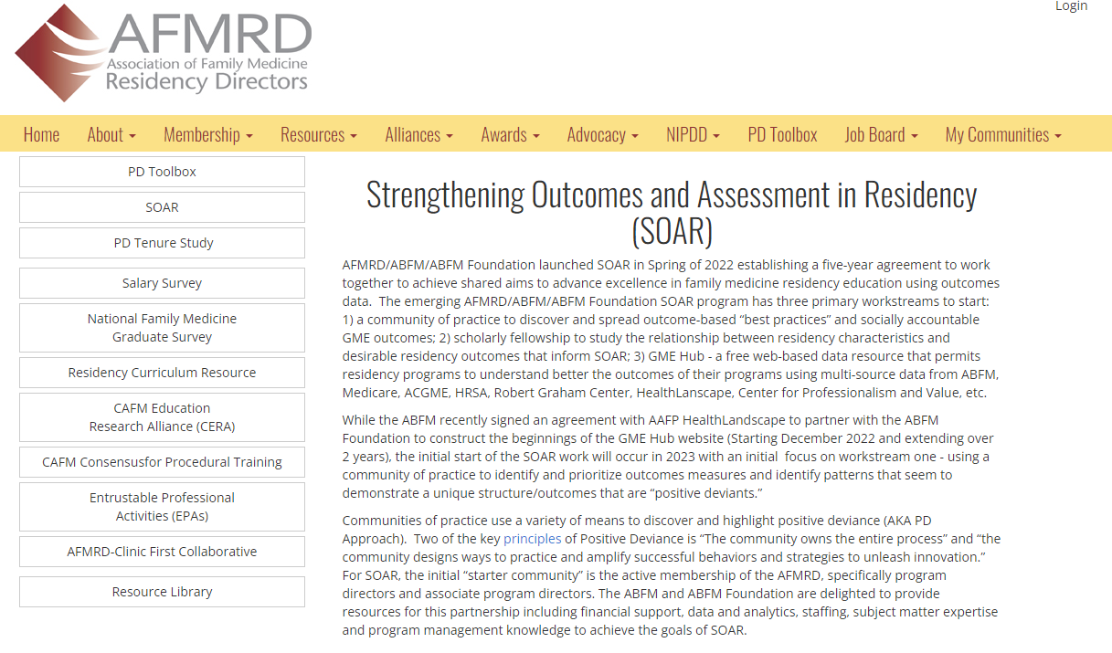
What is SOAR?
“…the initial start of the SOAR work will occur in 2023 with a focus on…
using a community of practice to identify and prioritize outcomes measures and identify patterns that seem to demonstrate a unique structure/outcomes that are “positive deviants.”
https://www.afmrd.org/page/soar

Slide 6
Early Advice in 2022 and 2023
Wendy Barr, MD
Sarah Cole, DO
Alexis Reedy Cooper,MD
Jay Fetter, MSHA
Jamal Islam, MD
Summer Jamison, Med
Warren Newton, MD
M. Grace Oliver, MD
Alexandra Verdieck, MD
ABFM and ABFM Foundation
AFMRD Board of Directors
Andrew Bazemore, MD
Lars Peterson, MD
HealthLandscape
AFMRD/ABFM National Graduate Survey Committee
Family Medicine Competencies and Assessments for Rural Practice
Notes:
Sarah to present this slide. In 2022 we established an advisory committee of residency program leaders, program administrators, recent family medicine residency graduates, data scientist, former program directors and health services researchers to help us start the design of SOAR.

Slide 7
Poll Question:
What position in your program is responsible for identifying and tracking residency outcomes?
Program Director
Associate Program Director
Program Administrator
PEC Member (s)
Another Core Faculty Member
DIO
Other

Slide 8
Poll Question:
What is your level of interest and experience in using residency outcome data for program advocacy and improvement work ?
High -- with limited experience
High -- with moderate experience
High -- with a lot of experience
Somewhat interested – limited experience
Somewhat interested – moderate experience
Not at all interested – moderate experience
Not at all interested- limited experience

Slide 9
Proposed initial outcomes to measure for SOAR
Pregnancy care
Behavioral health, including treatment of substance use disorder
Care of adolescents
Care of vulnerable populations
Notes:
Sarah – these conversation and insights prompted those stakeholders to prioritize these four outcomes for initial study though in about 20 minutes we’d like your thoughts on whether these are the right ones – we’d first like to give a demonstration of what a study of outcomes in these areas could look like/mean and for that, Sarah turns it over to Wendy and Lars

Slide 10
CERA ABFM National Family Medicine Residency Outcomes Project (FMROP)
Wendy B. Barr, MD, MPH, MSCE
Lars Peterson, MD, PhD

Slide 11
Project Goals
To understand the program level factors that are associated with family medicine resident outcomes of interest
To provide evidence-based guidance to family medicine residency leadership teams to guide changes in residency structure and curricula to achieve their desired family medicine graduate outcomes
Notes:
Wendy & Lars

Slide 12
Study Design – Prospective Cohort Study of
Family Physicians who Completed Residency in 2018
Exposures =
Residency Program (2014/2015 – 2018)
Measure with CERA Program Director Survey with ACGME Program IDs in Summer/Fall of 2018 (frame questions for Class of 2018)
Outcomes =
Family Medicine Residency Graduate Outcomes
(3 years post residency)
Measure with AFMRD ABFM National Graduate Survey of Class of 2018 (administered in 2021/2022)
Notes:
Wendy & Lars

Slide 13
Study Design – Survey Instruments
CERA Program Director Survey
Administered in Summer/Fall 2018
88 Questions
5 project proposals
AFMRD/CERA Steering Committee generated potential hypotheses
Omnibus questions
Survey results held until 2021 NGS
252 responses (43.34%)
National Graduate Survey (NGS)
Administered January 2021 to June 2022 to Class of 2018
Longer period due to low response rates due to COVID
1,623 responses (45%)
Notes:
Wendy & Lars

Slide 14
Study Flowchart
Residency Programs
(N= 581 )
Program Directors with CERA invites
N= 581
Residency Grads w NGS Invites
N= 3610
PDs Respond to CERA
N=252 (43%)
Grads Respond to NGS
N= 1623 (45%)
FMROP
N= 779 (48%)
(from 211 programs)
Program CERA
Grad NGS
FMROP Dataset
Notes:
Wendy & Lars

Slide 15
Research Objectives
Pediatrics
Impact of residency curriculum and characteristics on graduate care of children
FQHCs
Impact of residency location of family medicine practice site on graduate location and patterns of practice
Clinic Volume
Impact of continuity clinic volume on graduate practice patterns and wellness
SUD
Impact of residency processes and characteristics on graduate prescribing of buprenorphine (medication assisted therapy for substance use disorder)
Core Faculty
Impact of core faculty ratios on graduate’s scope of practice, practice patterns, burnout, career satisfaction, and residency satisfaction.
NIPDD
Impact of program director NIPDD training on graduate satisfaction with training, practice, and the profession
Inpatient Care*
Impact of residency curriculum on inpatient practice
Maternity Care*
Impact of residency curriculum and characteristics on graduate maternity care practice
Wellness & Career Satisfaction*
Impact of residency structure and curriculum on graduate wellness and practice satisfaction
Health Systems Management Training*
Impact of residency curriculum in health systems management (HSM) on graduate practice satisfaction and patterns
* CERA Project
Notes:
Wendy & Lars – minimize info overload by exclusively focusing on pediatric and maternity care arms

Slide 16
Characteristics of 2018 Family Medicine Graduates Included in FM-ROP Cohort
Age ​(Mean (SD))​ | 35.7 (3.9) ​
Gender ​(% Female) ​ | ​ 55.0% ​
Degree ​(% MD) ​ | ​ 77.3% ​
Non-US Graduates ​ (% Non-US Grads) ​ | ​ 30.3% ​
​ Race ​ | ​ ​
​ -White ​ | ​ 61.5% ​
​ - Black ​ | ​ 8.2% ​
​ -Asian ​ | ​ 21.5% ​
​ -Native ​ | ​ 1.0% ​
​ - All others ​ | ​ 7.9% ​
​ Ethnicity ​ | ​ ​
​ -Hispanic ​ | ​ 9.0% ​
​ - Non-Hispanic ​ | ​ 91.0% ​
FM-ROP Cohort​
N= 779​
Notes:
Wendy & Lars

Slide 17
FM-ROP Cohort Program Demographics
(N=779, representing 211 programs)
Program GME Funding​ | ​
- CMS​ | 91.6%​
- THC​ | 8.4%​
- State GME​ | 57.0%​
- DOD​ | 4.3%​
- VA​ | 8.0%​
- Foundation/Other​ | 41.6%​
Program Accreditation in 2015​ | ​
- ACGME​ | 75.2%​
- AOA​ | 0.4%​
- Duel ACGME/AOA​ | 24.4%​
Single Residency Institution (%)​ | 37.1%​
Program % Non-US Grads in Last 5y​ | ​
- 0-24%​ | 65.5%​
- 25-49%​ | 14.0%​
- 50-74%​ | 11.9%​
- 75-100%​ | 8.5%​
Primary Hospital Training Site​ | ​
- Academic Medical Center​ | 24.0%​
- Large Comm Hospital (>200 beds)​ | 61.3%​
- Small Comm Hospital (<200 beds)​ | 14.8%​
Primary Clinic Training Site​ | ​
- Hospital Based​ | 49.3%​
- Non-hospital, non-profit​ | 20.5%​
- Non-hospital, for-profit​ | 6.8%​
- FQHC/Rural Health Center​ | 14.9%​
- Military​ | 3.0%​
Program Size​ | ​
- <19 residents​ | 16.4%
- 19-31 residents​ | 49.7%
- >31 residents​ | 28.6%
Program Type​ | ​
- University Based​ | 23.2%
- Comm-Based​ | 67.6%
- Military​ | 4.1%
Program Year Founded​ | ​
- Before 1990​ | 81.2%​
- 1991-2000​ | 12.6%​
- 2001-2015​ | 6.4%​
Program Community Type​ | ​
- Inner City​ | 15.3%​
- Urban/Suburban​ | 34.0%​
- Suburban​ | 31.2%​
- Rural​ | 13.4%​
Program Location​ | ​
- Midwest​ | 24.4%​
- Northeast​ | 11.7%​
- South​ | 28.4%​
- West​ | 33.5%​
Notes:
Wendy & Lars

Slide 18
Preliminary Results
How SOAR might use a similar line of study
Notes:
Wendy & Lars

Slide 19

Care of Children
Notes:
Wendy & Lars

Slide 20
Poll Question:
Which residency processes are associated with graduates being more likely to practice outpatient pediatrics?
  Having 4 or more months of curricular time in pediatrics
  Continuity clinic patients - >10% under age 10
  Have 2 or more faculty members who see and supervise care of newborns and/or inpatient pediatrics

Slide 21
Which residency process is associated with graduates being more likely to practice outpatient pediatrics?
Continuity clinic patients - >10% under age 10
Have 2 + faculty members who see and supervise care of newborns and/or inpatient pediatrics
Notes:
Wendy & Lars – use of audience engagement system

Slide 22
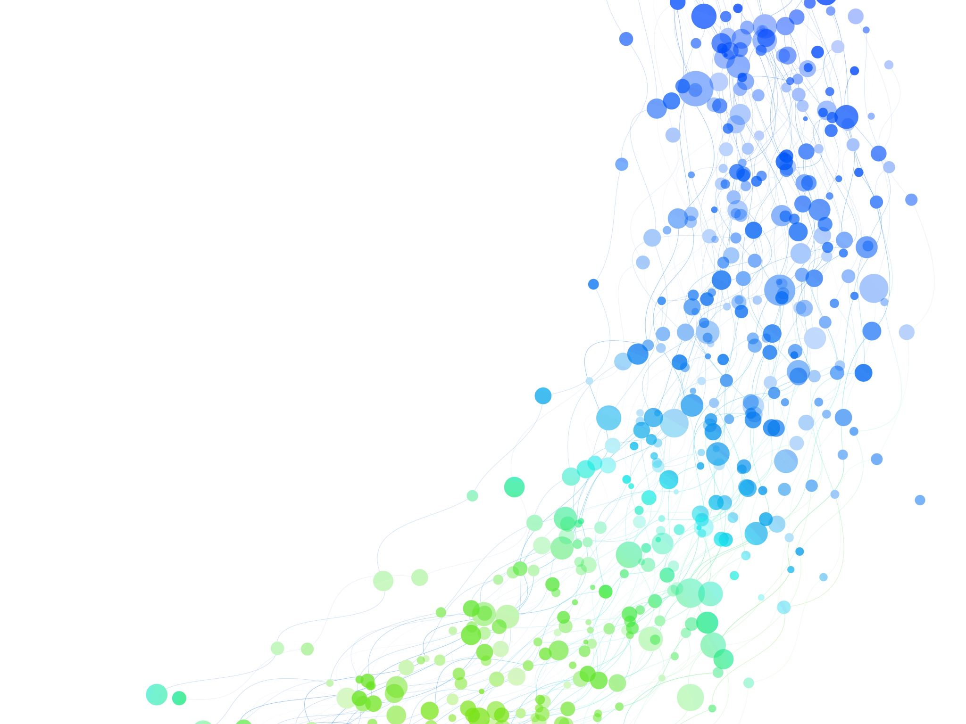
Pregnancy Care
Notes:
Wendy & Lars – if this begins to feel too long, could reduce to either care of children or pregnancy care (ie, one or the other but not both)

Slide 23
Poll Question:
Which residency process is associated with graduates being more likely to deliver babies?
  Having 4 or more months of curricular time in pregnancy care
  Performing 80 or more deliveries in residency
  Have 2 or more faculty members who deliver babies
  Continuity Delivery Requirement

Slide 24
Which residency process is associated with graduates being more likely to be delivering babies?
Having 4 or more months of curricular time in pregnancy care
Performing 80 or more deliveries in residency
Notes:
Wendy & Lars

Slide 25
Which residency process is associated with graduates being more likely to be delivering babies?
Have 2 or more faculty members who deliver babies
Continuity Delivery Requirement
Notes:
Wendy & Lars

Slide 26
Study Implications
First national cohort study in any specialty that follows an entire year of residency graduates by assessing program director perspectives on their training, including program structures and processes, and then linking this to graduate survey data that includes post-graduation practice patterns and outcomes.
Findings from this project can help inform program directors around what resident structures and processes to prioritize as they develop new programs or redesign programs with the opportunities provided by the new ACGME requirements so that they graduate family physicians who will practice in locations and scope of practice that their communities need.
Notes:
Wendy & Lars – summarize and then kick it over to Sarah to highlight why this matters to PDs who are learning about new ACGME program requirements for GME in FM

Slide 27
Each FMP site must involve all members of the practice in ongoing performance improvement and must demonstrate use of outcomes in improving clinical quality, patient satisfaction, patient safety and financial performance.
Section I.D.1.a. 10
Notes:
Sarah

Slide 28
Why? Program Evaluation Committee
Program Evaluation Committee responsibilities includes guiding ongoing program improvement, including development of new goals, based upon outcomes. (V.C.1.b).(3))
  The Program Evaluation Committee utilizes outcome parameters and other data to assess the program’s progress toward achievement of its goals and aims.
The Program Evaluation Committee should consider in its assessment of the program aggregate resident achievement of the Milestones, in-training examinations, board pass and certification rates and graduate performance. (V.C.1.c).(6))
The Program Evaluation Committee must evaluate the program’s mission and aims, strengths, areas for improvement, and threats. (V.C.1.d)
Notes:
Sarah – explains above and how one source of data is the NGS results that all participants have in hand for today’s table discussions then kicks it back over to Wendy to briefly highlight aspirational sources of future data

Slide 29
Next Steps:
Aspirational FM GME Process and Outcomes Data
Pre-Res
ERAS
NRMP
Medical School EPAs
R1
ITE
Milestones
ABFM Resident Survey
EMR Clinical Data
R2
ITE
Milestones
ACGME WebADs
ABFM Resident Survey
R3
ITE
Milestones
ACGME WebADs
ABFM Initial Cert Survey
ABFM Certification Exam
Graduate – 3ys
ABFM National Graduate Survey
CMS Claims Data
AMA Masterfile
Graduate – q3y
ABFM Practice Demo Survey (PDS)
EMR Clinical Data
ABFM Resident Survey
EMR Clinical Data
ABFM Continuous Certification Survey (CCS)
CMS Claims Data
AMA Masterfile
Residency Master File
Notes:
Wendy – explains above then kicks it over to whoever will be guiding the large group/table facilitators through table discussions

Slide 30
Focused Table Discussion: Conversation Café Session
Notes:
Sarah

Slide 31
Introduce yourselves & describe one outcome of your program of which you are proud. [Brag Session]
Check in with table facilitator
Notes:
Jay/?Sarah

Slide 32
How do you differentiate an an outcome of residency versus a process in residency? How are they used for improvement work?
Notes:
Jay/?Sarah

Slide 33
What outcomes should the community of family medicine assess? What processes should the community of family medicine assess along the way to those outcomes?
Notes:
Jay/?Sarah

Slide 34
When you go home, what outcomes are you going to study within your Program Evaluation Committee &/or think about for your Annual Program Evaluation?
Notes:
Jay, for sure

Slide 35
Poll Question:
What is your level of interest in joining the SOAR Community of Practice
High – sign me up now
Interested and would like more information sent to me
Might be interested if it could help me meet program requirements
Not interested at this time

Slide 36
Poll Question:
What is your level of interest in helping SOAR conduct research on residency outcomes by serving as a research fellow?
High – sign me up now
Interested and would like more information sent to me
Might be interested if it didn’t take too much time
Not interested at this time

Slide 37
Poll Question:
Now that’s you’ve hear about SOAR, what is your level of interest in using residency outcome data for program advocacy and improvement work ?
High
Somewhat interested
Not at all interested

